Slide 1
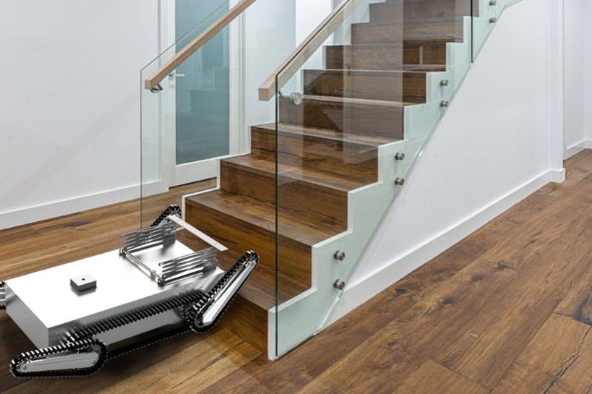
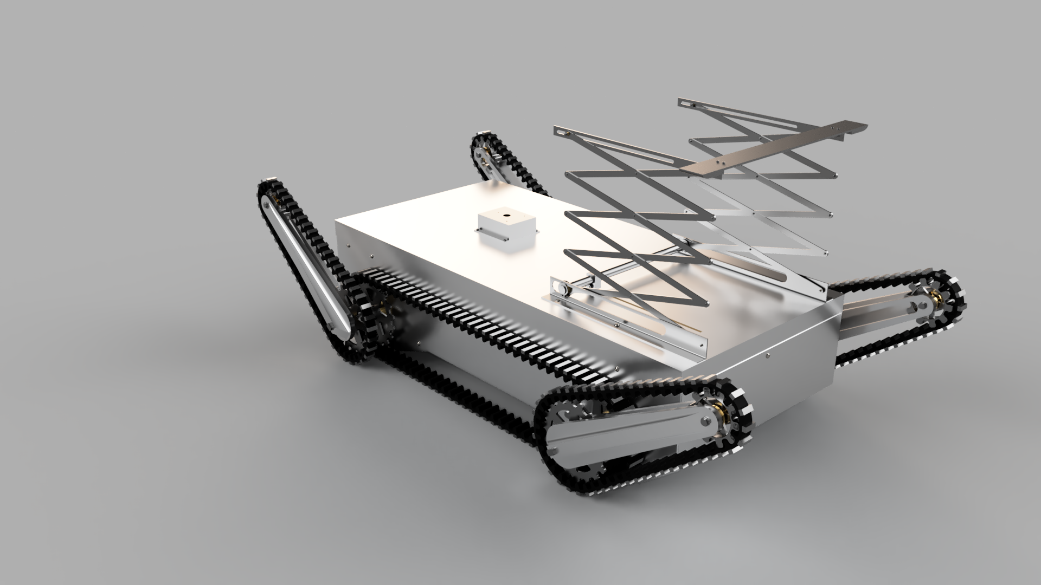

FireBee Search and Aid Vehicle
Elian, Emily, Esi, Phil
Notes:
Hi and welcome to our FireBee search and aid vehicle presentation.

Slide 2
Brief
Design an unmanned mobile search and exploration robot to assist in the firefighting operation within residential buildings during a fire emergency.
Must:
Be highly portable
Deployable from a rucksack
Carry a payload of cameras/sensors/communication devices
Climb stairs
Open doors
Notes:
We were given the brief to produce a robot to aid the fire service in searching and exploring residential buildings during a fire emergency. The robot needed to be portable, carry a payload of cameras and sensors, climb stairs and open doors.

Slide 3
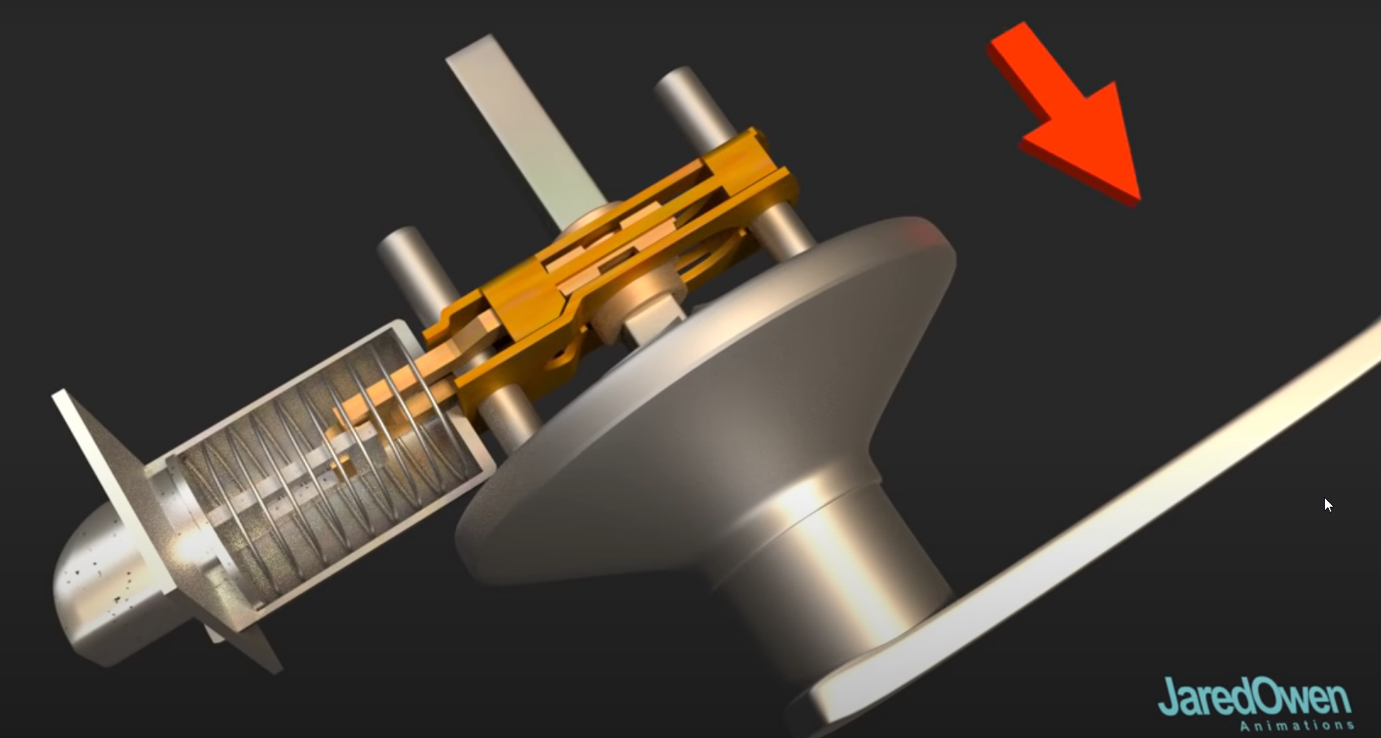
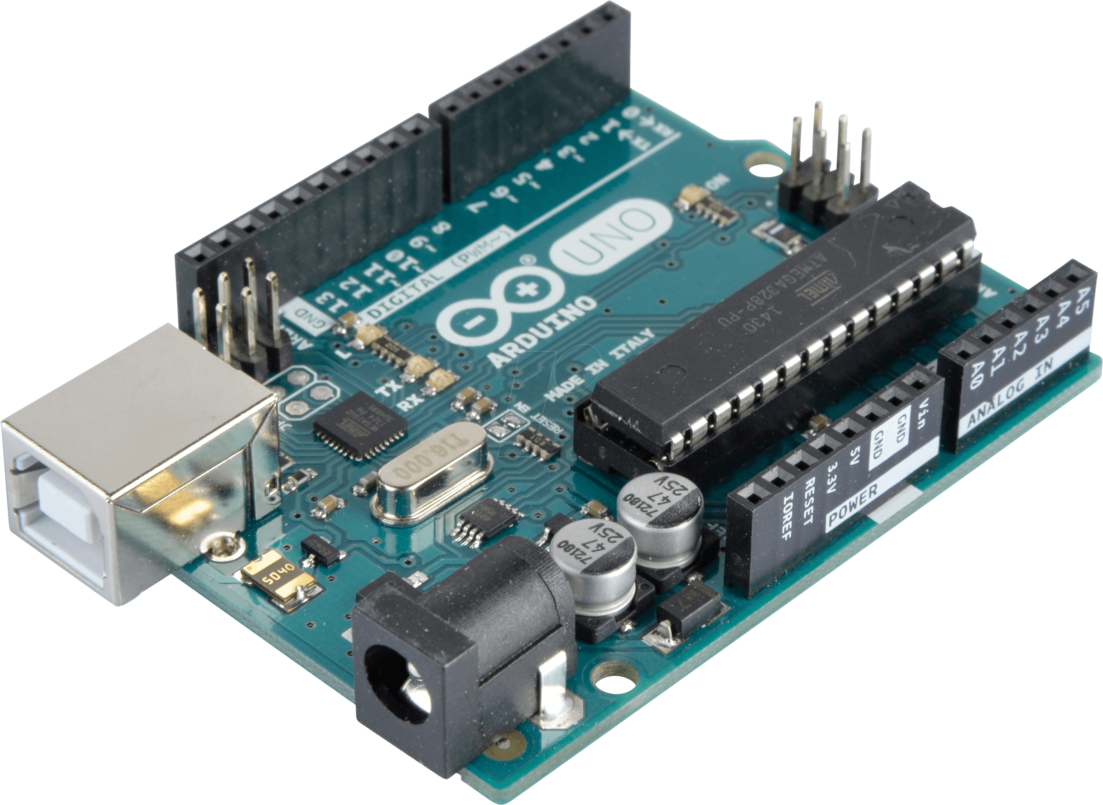
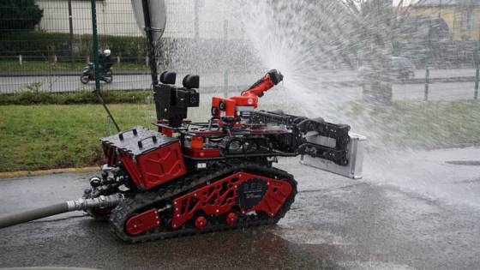
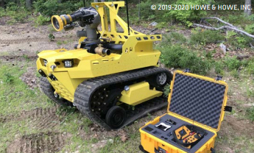
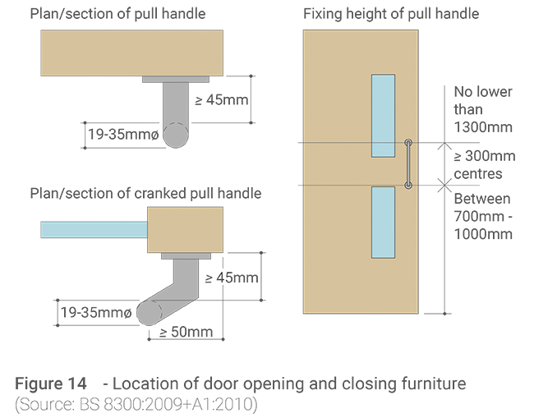
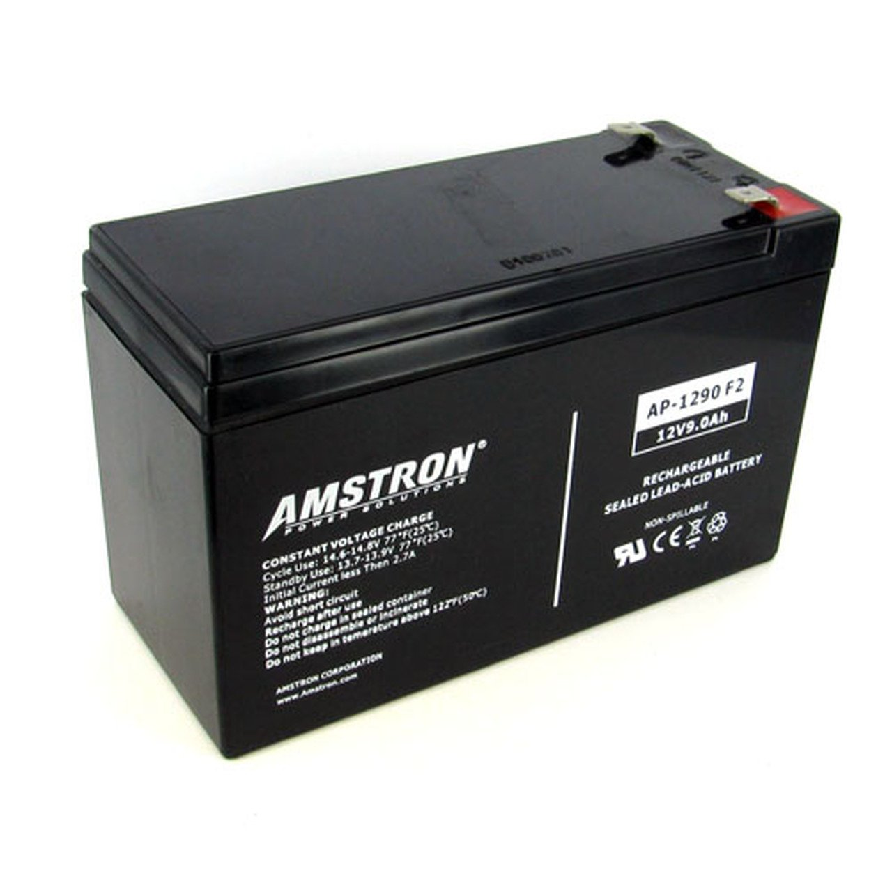
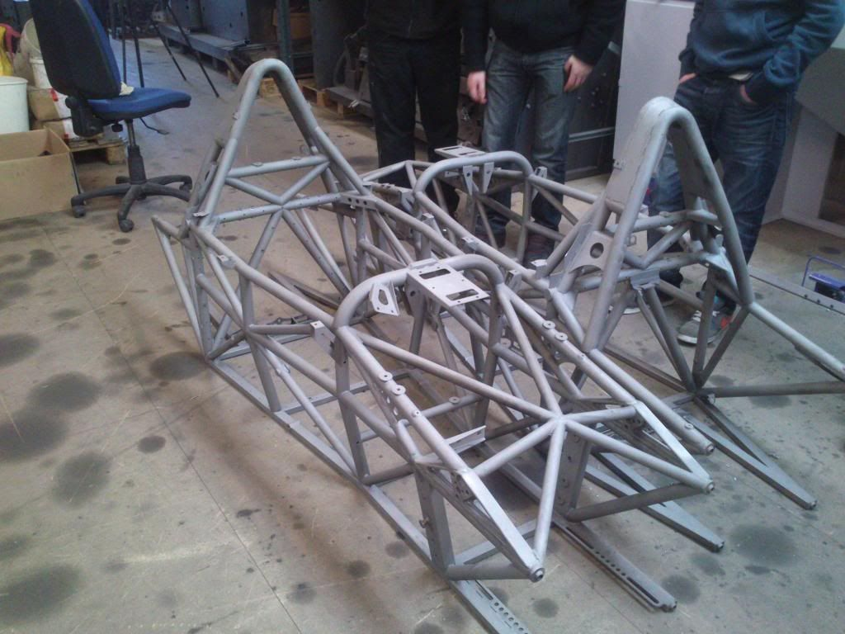
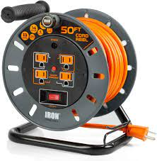
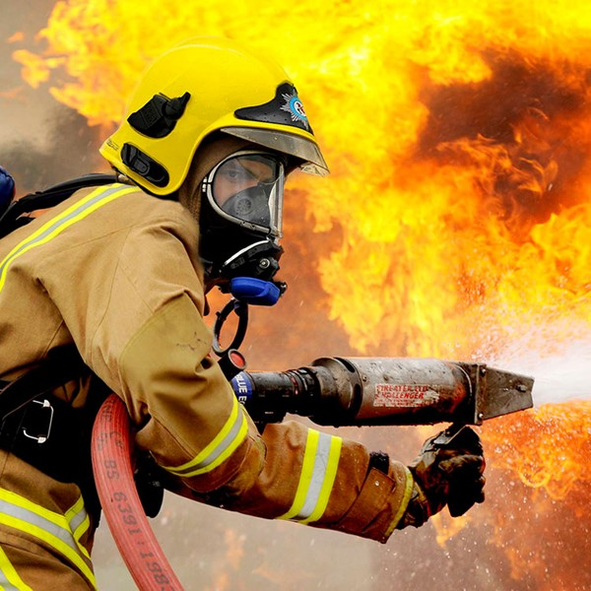
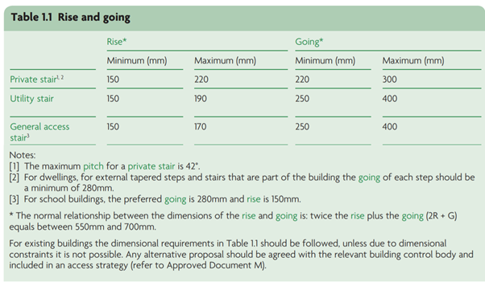
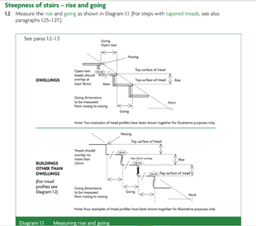
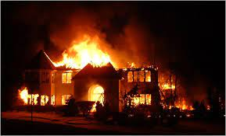
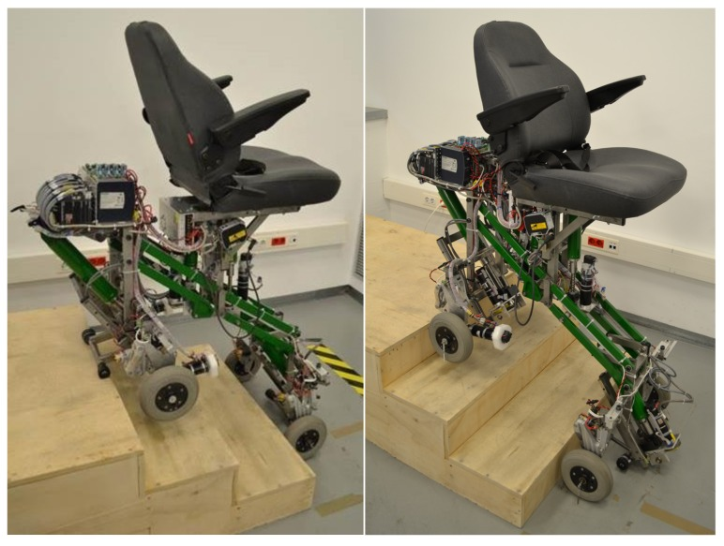
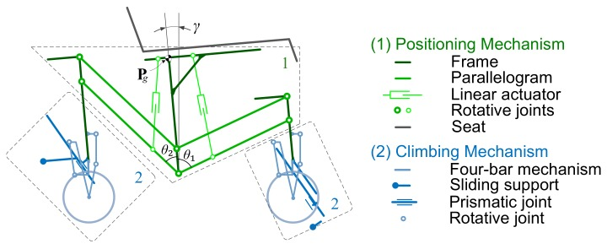
Power/Control
Door Handles/Locks
Existing Products
Research
Batteries
Materials
House Dimensions
Moving Mechanisms
Fire Service
Notes:
From our brief we highlight eight areas to research. These were door handles/locks, existing products, materials, the fire service and environment our robot would be functioning in, existing mechanism for climbing stairs, and average house dimensions.

Slide 4
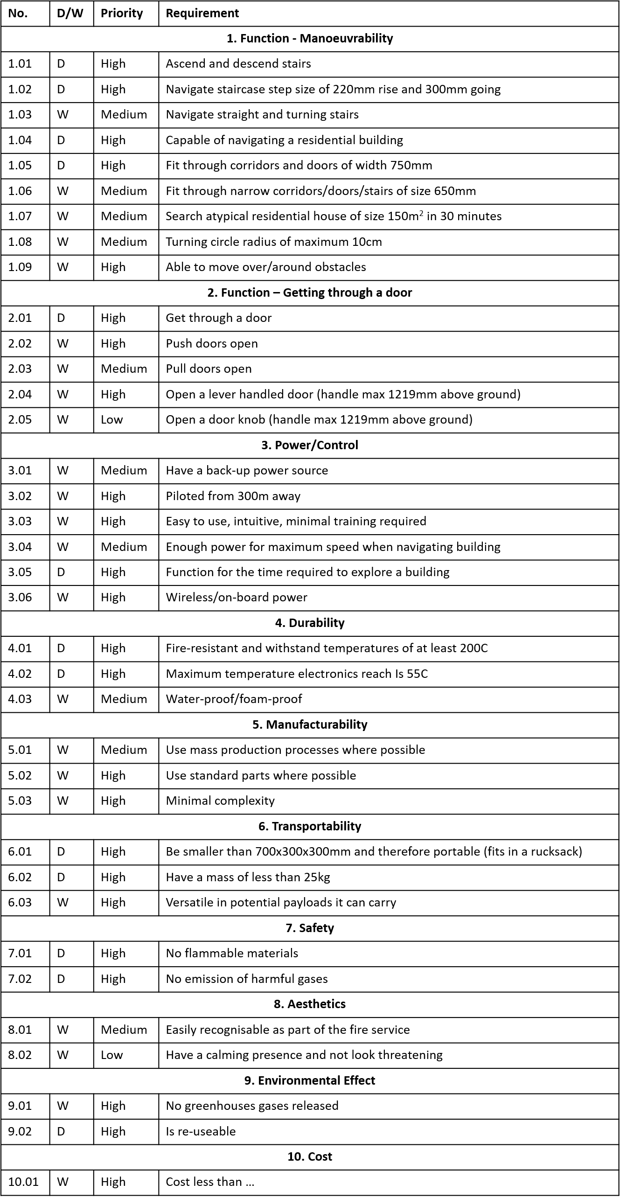
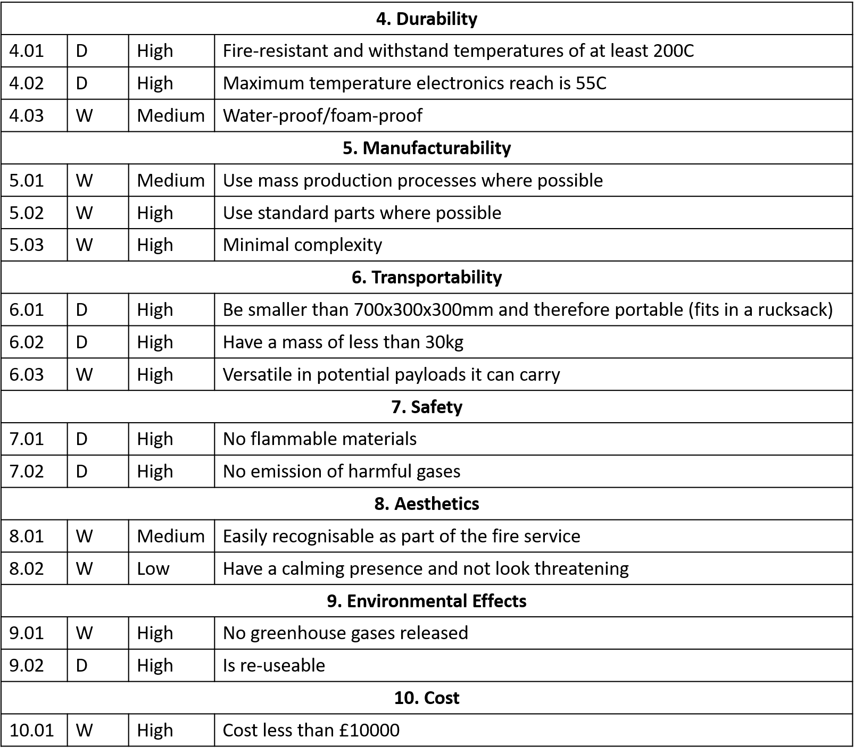
Specification
Notes:
Using both the brief and our research we created a detailed, quantified design specification.

Slide 5
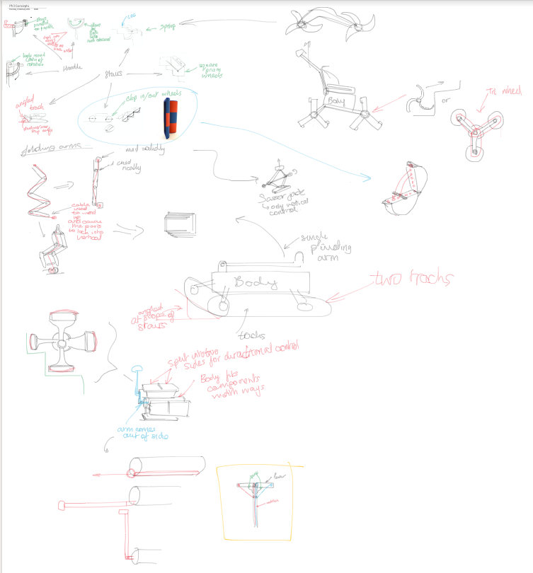
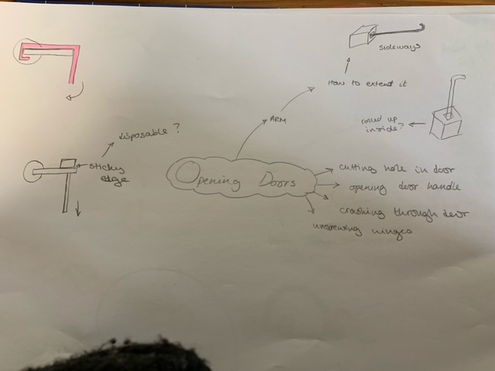
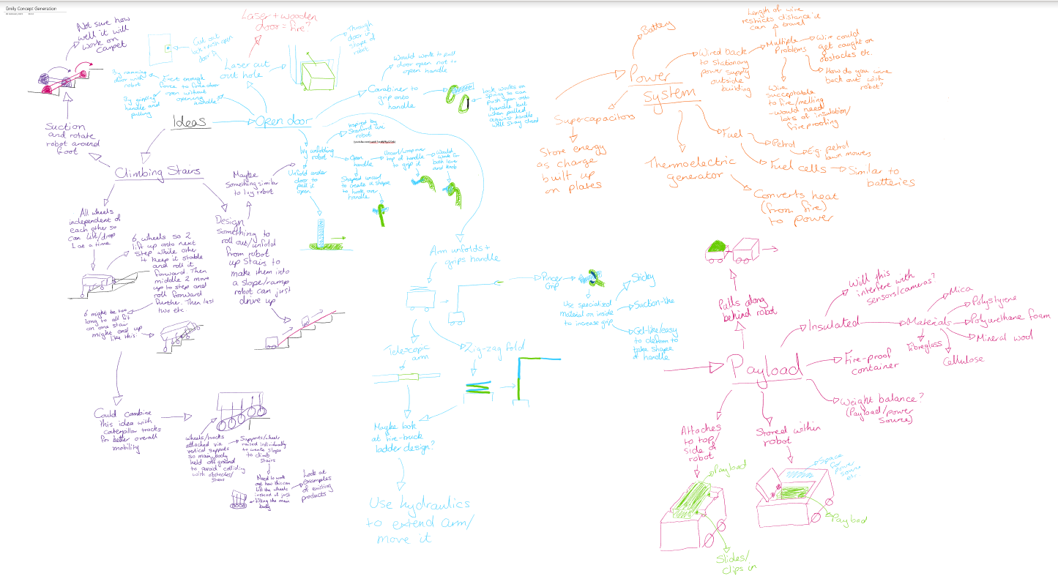
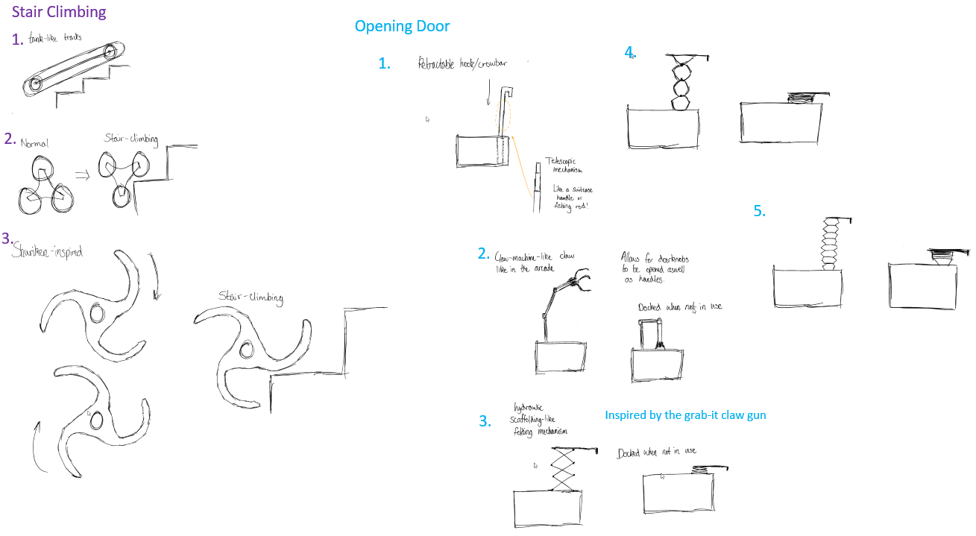
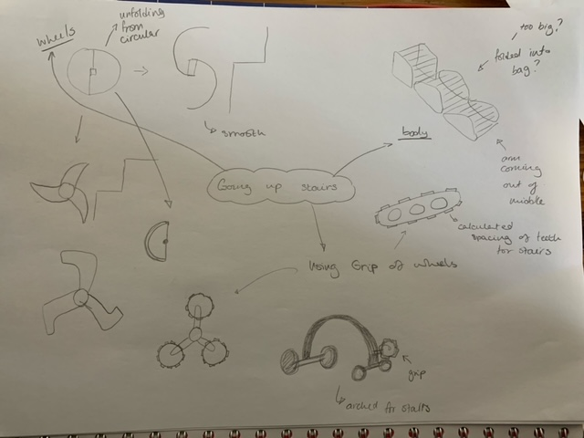
Concept Generation

Slide 6
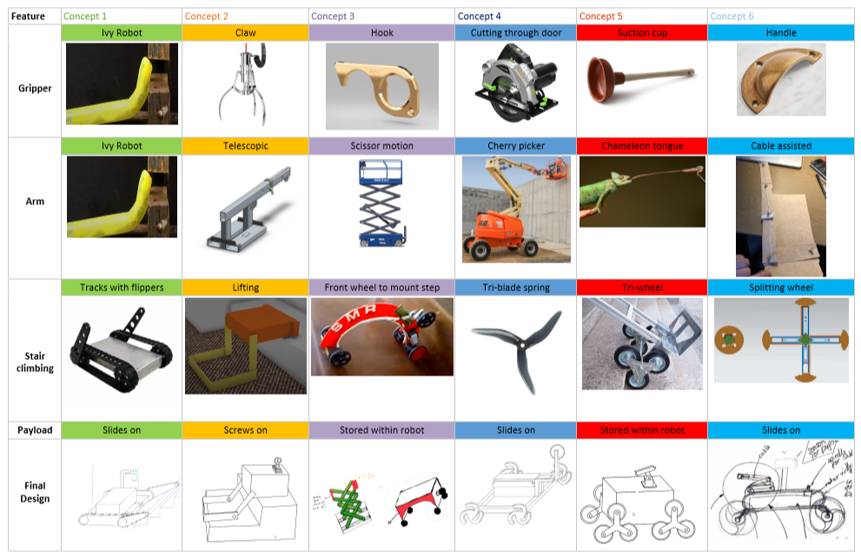
Morphological Chart
Notes:
To combine these ideas into full concepts we used a morphological chart. We discussed our ideas from the concept generation, using feasibility and common sense checks to remove some. Examples of ideas removed include using sunction to climb stairs, as it was unlikely to work on carpet, towing the payload behind the robot, as this would be unable to climb stairs, and ramming the door open, as this would be dificult to achieve with a rucksack sized robot. This left us with 6 feasible concept options as seen here.

Slide 7
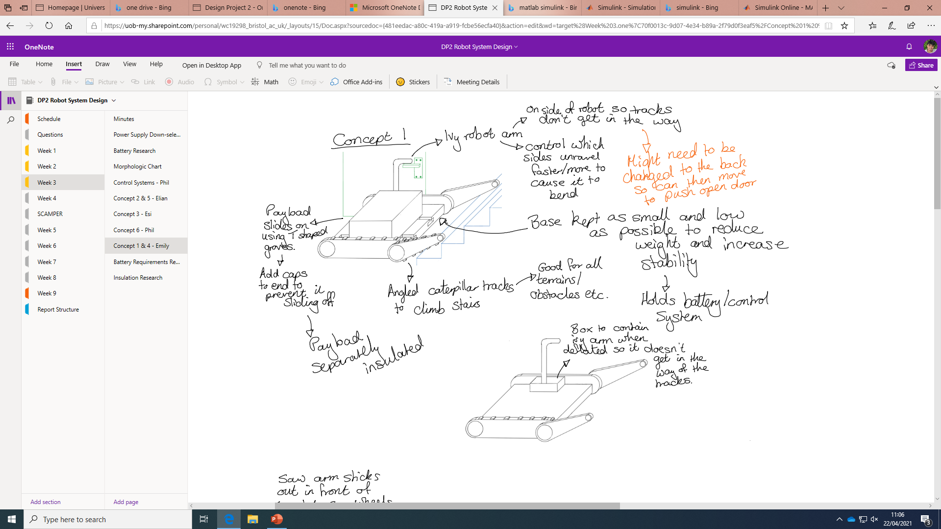
Concept 1
Notes:
Concept 1 used an arm inspired by Stanford university’s ivy robot, which uses air pressure to unravel a tube of material into an arm, however this was unlikely to be durable enough for use in fire fighting situations. We did like the tracks used for movement and stair climbing on this concept, ultimately using them in the final design.

Slide 8
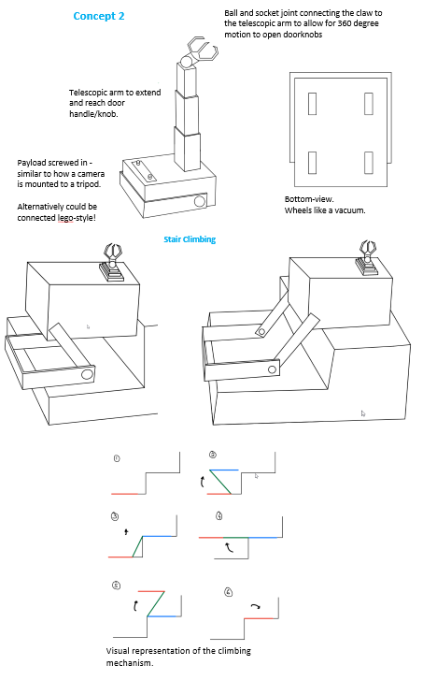
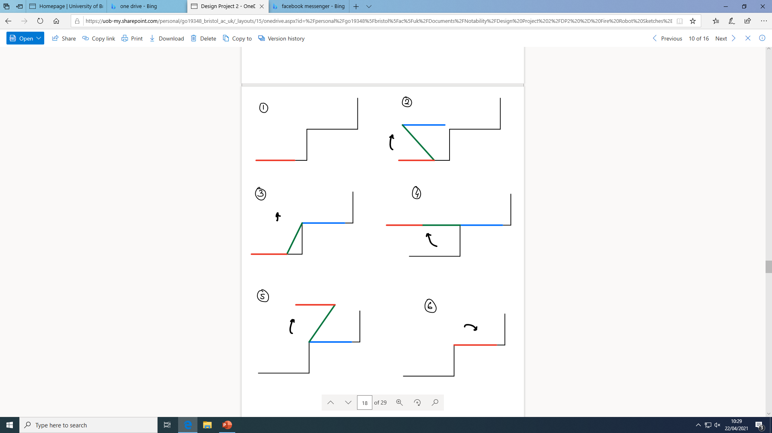
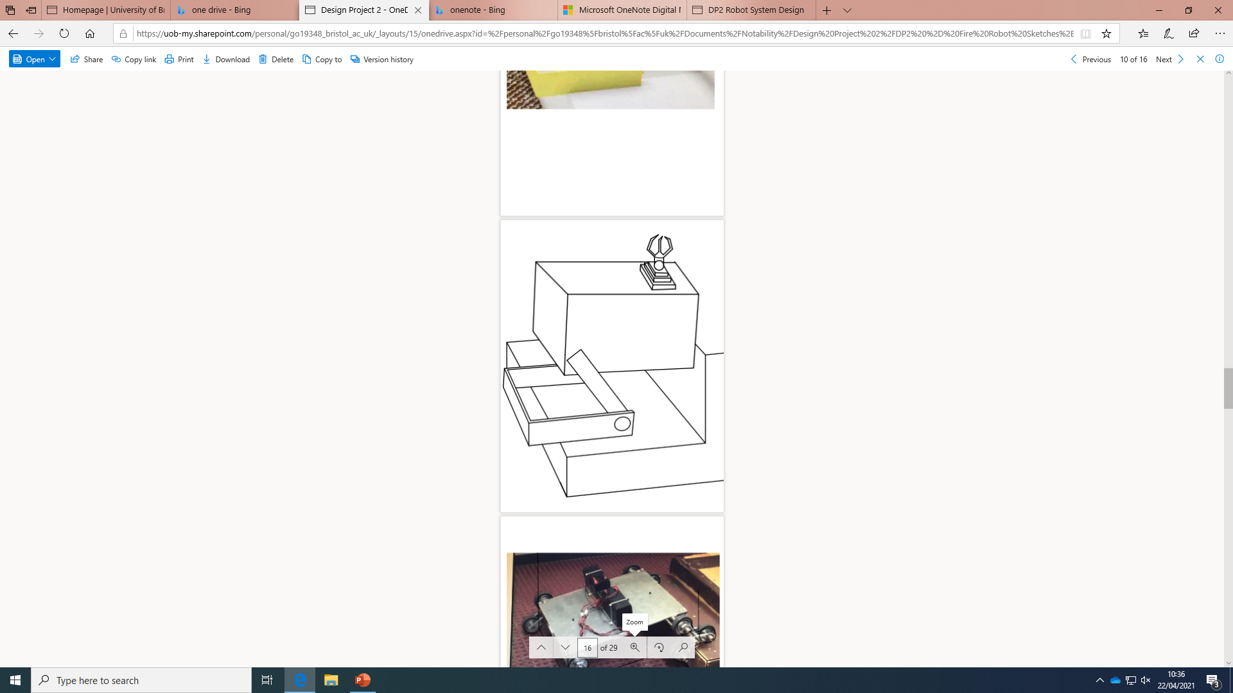
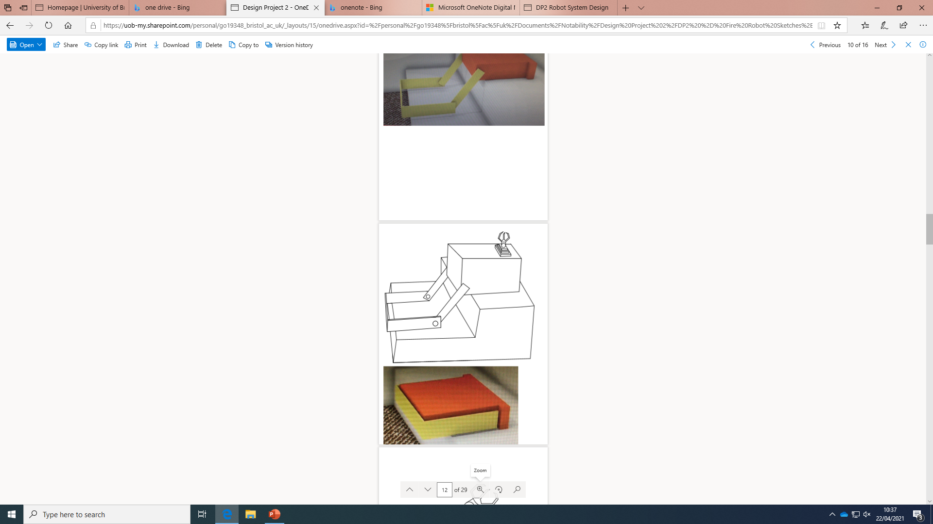
Concept 2
Ball and socket joint connecting the claw to the telescopic arm to allow for 360-degree motion to open doorknobs
Telescopic arm to extend and reach door handle/knob.
Payload screwed in - similar to how a camera is mounted to a tripod.
Alternatively, could be connected lego-style!
Bottom-view.
Wheels like a vacuum.
Visual representation of the climbing mechanism
Notes:
Concept 2 involved two different moving mechanisms for climbing stairs and lateral movement. It had small wheels underneath for the latter, and had a rotating arm to lift itself up the stairs. It also had a telescopic arm and claw connected via ball and socket for 360 degree movement. While these features were very versatile, the complexity of the mechanisms involved was a major drawback.

Slide 9
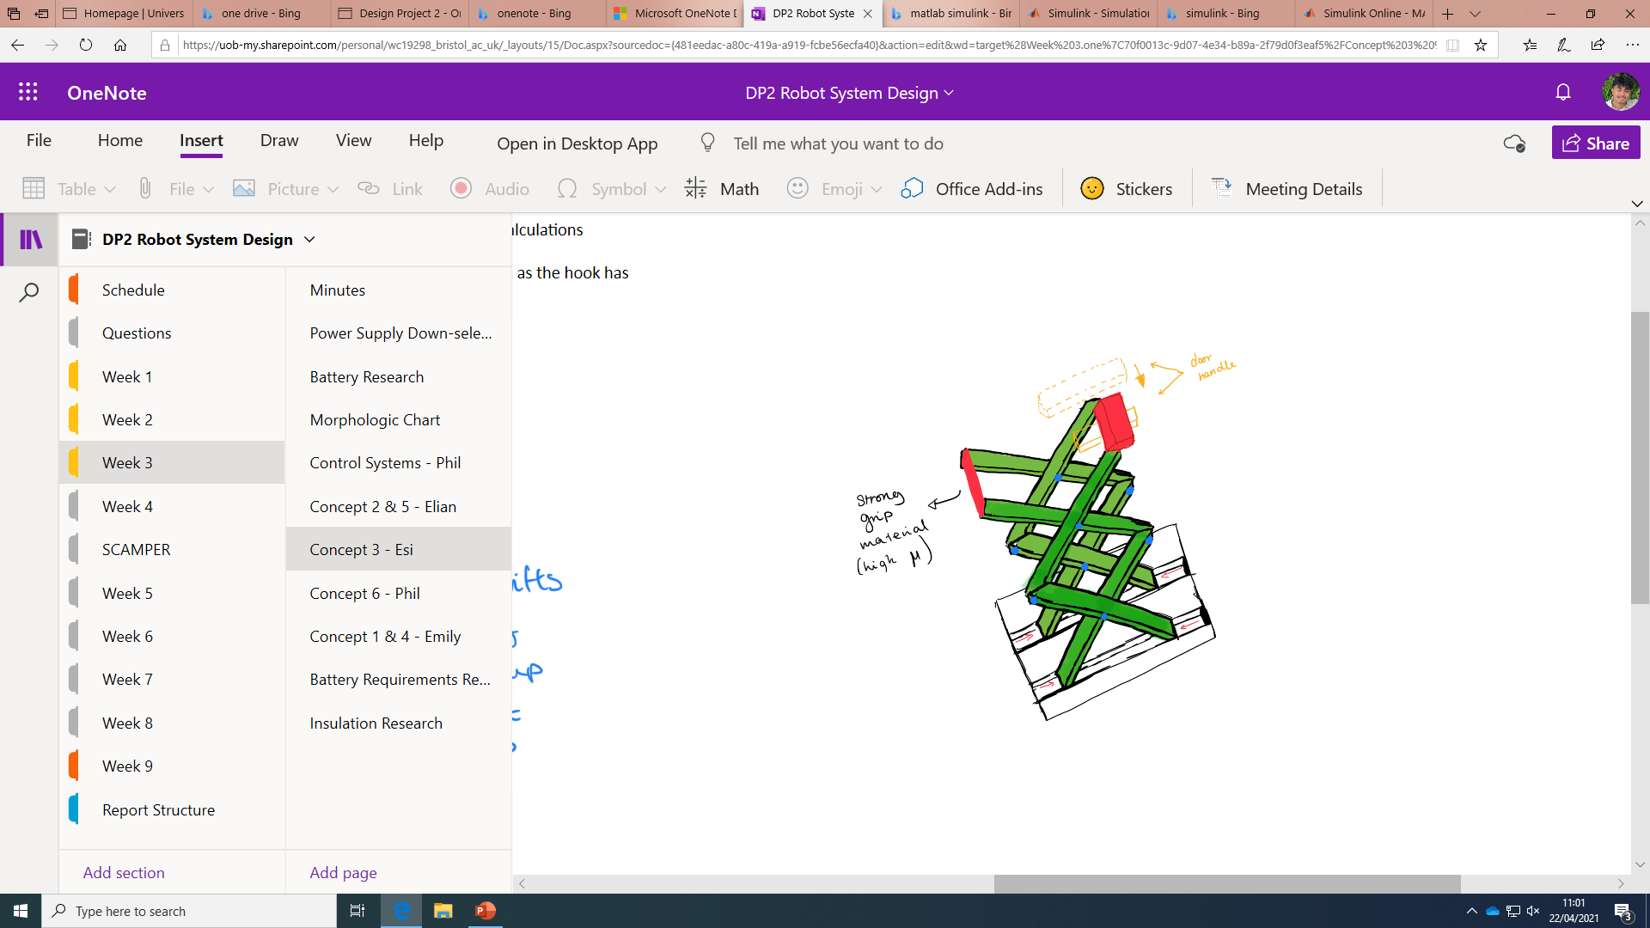
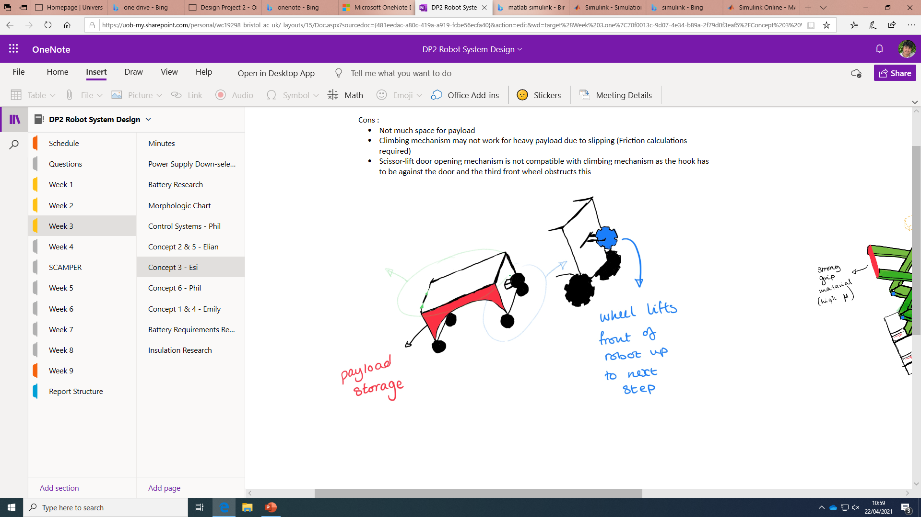
Concept 3
Notes:
Concept 3 used a scissor lift with a horizontal bar on the top to pull the door handle downwards. It had an additional wheel fixed on the front to lift the robot up, allowing it to climb stairs. However, in order to do this the robot needed to have a semi-circle cut out underneath, limiting inside space for components, mechanisms and the payload which was also stored inside.

Slide 10
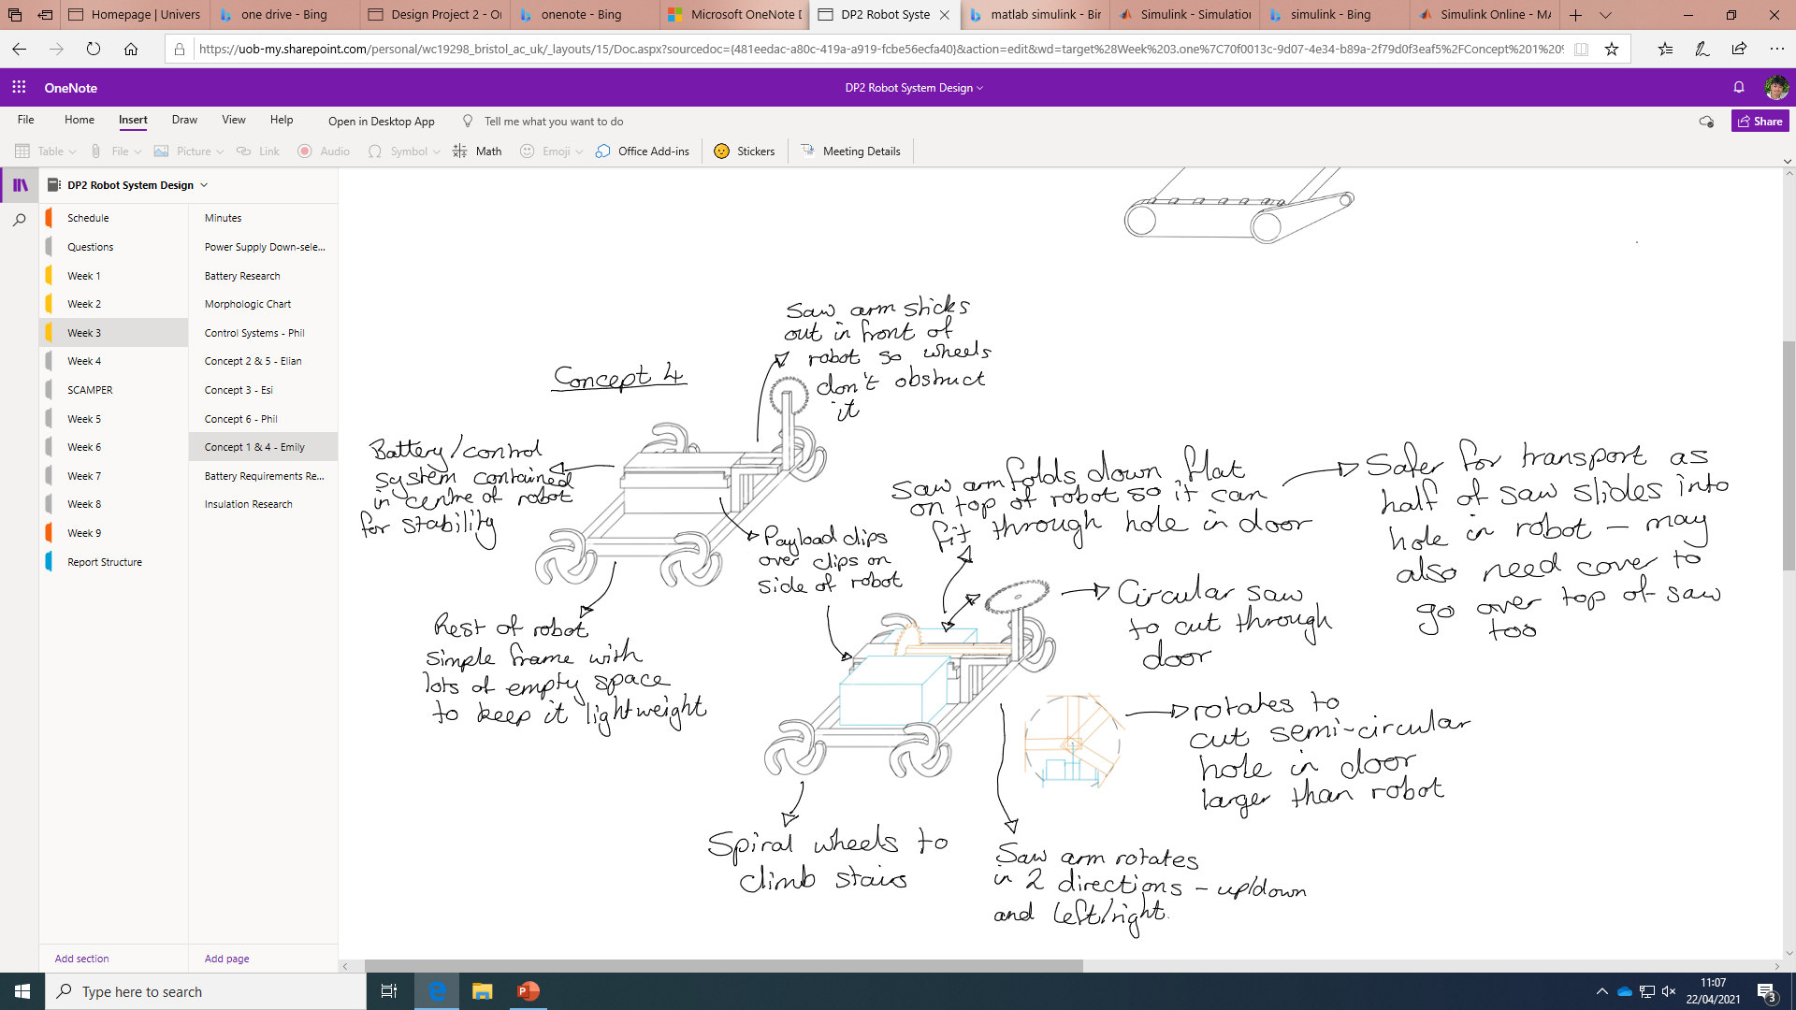
Concept 4
Notes:
Concept 4 had a circular saw fixed to the front of the robot to cut through the door, as opposed to opening it. While it could fold down when not in use, this still posed more of a safety concern than the other concepts, and would take longer to get through each door. The payload clipped onto the sides of the robot, and it had spiral shaped wheels to climb the stairs.

Slide 11
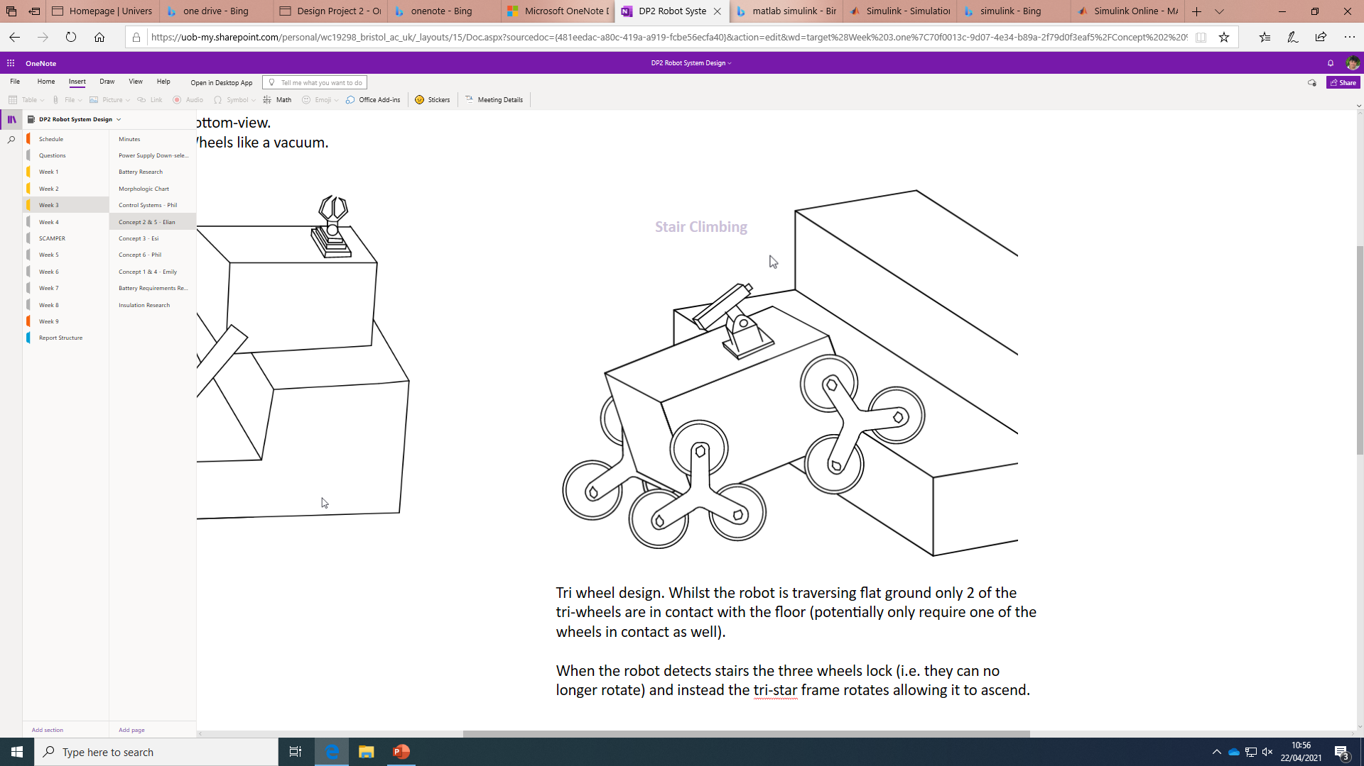
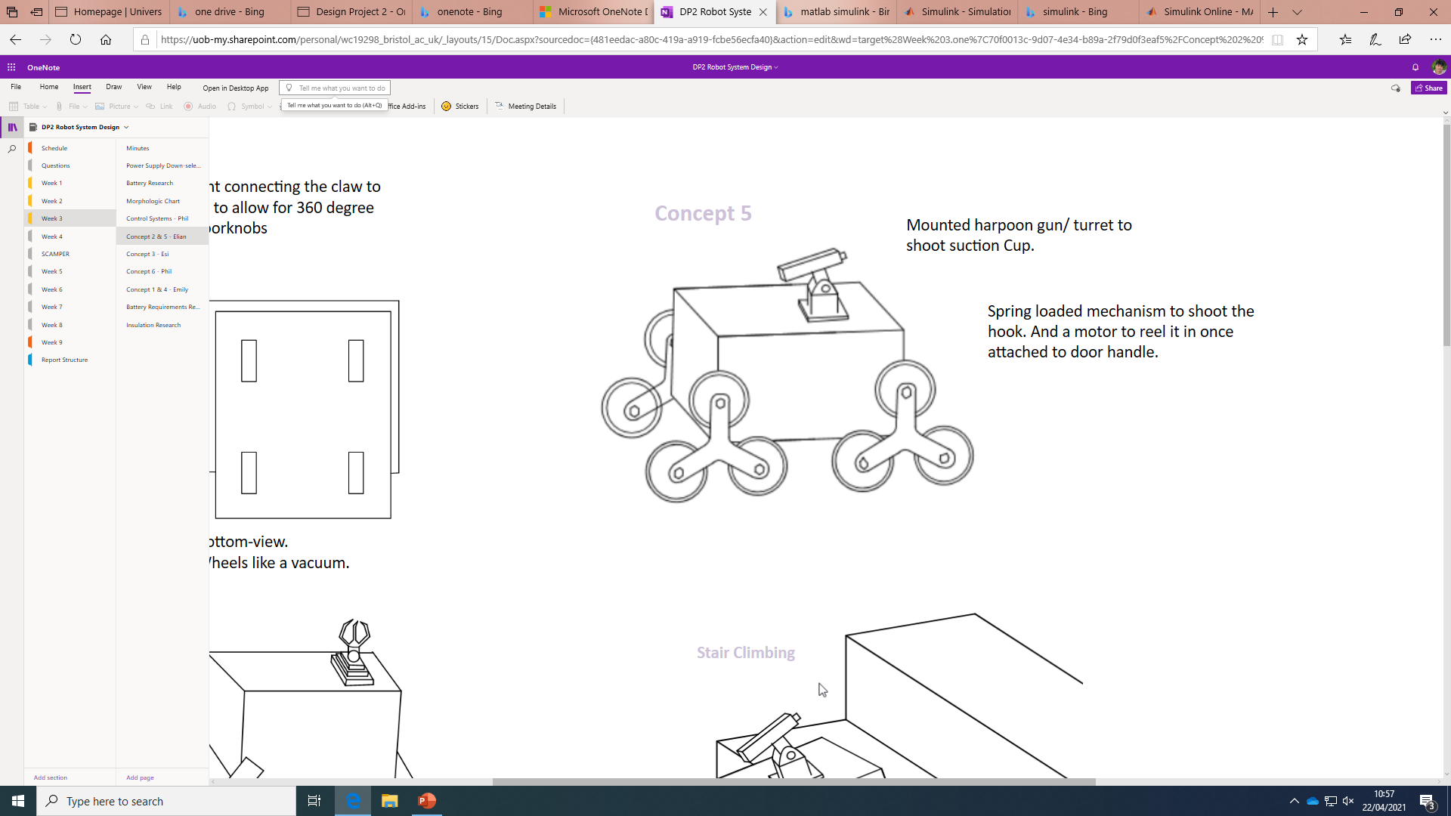
Concept 5
Mounted harpoon gun/ turret to shoot suction cup.
Spring loaded mechanism to shoot the hook. Motor to reel it in once attached to door handle.
When the robot detects stairs the three wheels lock and instead the tri-star frame rotates allowing it to ascend.
Tri wheel design. Whilst the robot is traversing flat ground only 2 of the tri-wheels are in contact with the floor - could potentially only require one of the wheels in contact also.
Notes:
Concept 5 was inspired by a chameleon tongue and included a harpoon gun that could shoot a suction cup to latch onto the door handle to pull it open. This was not very practical as it would take very precise calculations and aim to ensure the hook hit the door handle each time. It used tri-wheels to climb the stairs.

Slide 12
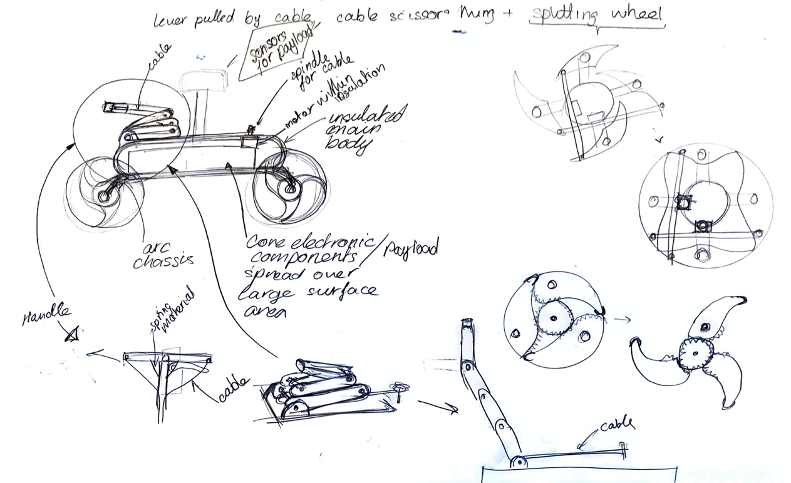
Concept 6
Notes:
Concept 6 used a splitting wheel design to allow for both lateral movement and stair climbing. This had the same manoeuvrability up stairs as the spiral wheels in concept 4, but improvement lateral movement as the wheels collapse into a more traditional shape when on flat ground. It used a folding arm control using cables and pulleys, to open a door handle.

Slide 13
Downselection - MCDA
 |  | Concept 1 |  | Concept 2 |  | Concept 3 |  | Concept 4 |  | Concept 5 |  | Concept 6
Criteria | Weighting | S | W | S | W | S | W | S | W | S | W | S | W
Function – Manoeuvrability | 9 | 5 | 45 | 3 | 27 | 2 | 18 | 2 | 18 | 4 | 36 | 4 | 36
Function – Getting through a door | 9 | 3 | 27 | 5 | 45 | 5 | 36 | 2 | 18 | 2 | 18 | 4 | 36
Durability | 8 | 2 | 16 | 3 | 24 | 4 | 32 | 1 | 8 | 3 | 24 | 3 | 24
Manufacturability | 5 | 4 | 20 | 2 | 10 | 4 | 30 | 3 | 15 | 3 | 15 | 3 | 15
Transportability | 6 | 3 | 18 | 5 | 30 | 2 | 12 | 2 | 12 | 3 | 18 | 4 | 24
Safety | 4 | 2 | 8 | 4 | 16 | 4 | 16 | 1 | 4 | 3 | 12 | 4 | 16
Aesthetics | 1 | 4 | 4 | 4 | 4 | 4 | 4 | 2 | 2 | 4 | 4 | 4 | 4
Environmental effects | 2 | 3 | 6 | 4 | 8 | 4 | 8 | 2 | 4 | 4 | 8 | 4 | 8
Cost | 3 | 4 | 12 | 2 | 6 | 5 | 15 | 3 | 9 | 3 | 9 | 4 | 12
Total | 235 | 30 | 156 | 32 | 170 | 33 | 161 | 18 | 90 | 29 | 144 | 34 | 175
% of total |  |  | 66% |  | 72% |  | 69% |  | 38% |  | 61% |  | 74%
Notes:
We used a multi-criteria decision analysis, based off the categories from our design specification, to downselect these 6 concepts. Concept 6 scored the best, as the splitting wheels offered good manoeuvrability on both stairs and flat floors, the handle fulfilled the brief of opening level handled doors well, and the robot was durable, easily transportable and the mechanisms involved were relatively simple. We also considered key features from other concepts that scored highly, such as the tracks from concept 1 and the telescopic and scissor lift arms from concepts 2 and 3 respectively, and used these to make refinements to concept 6 to produce the final design.

Slide 14
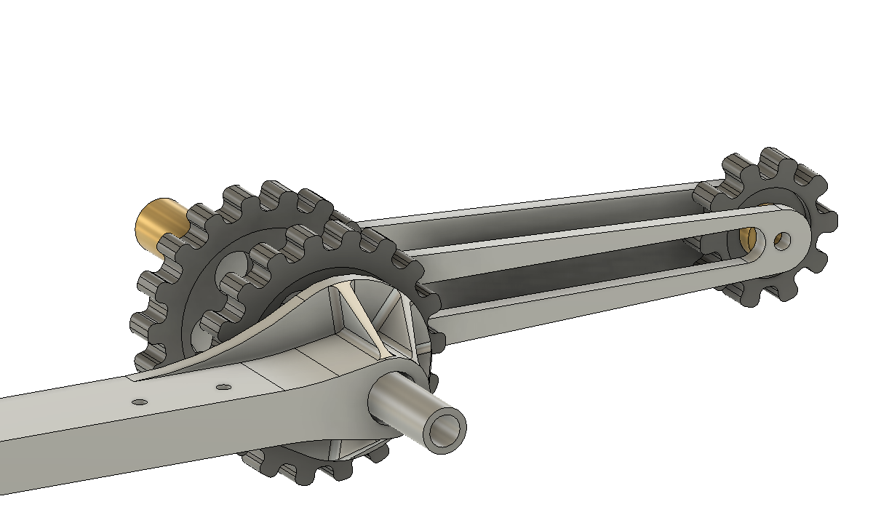
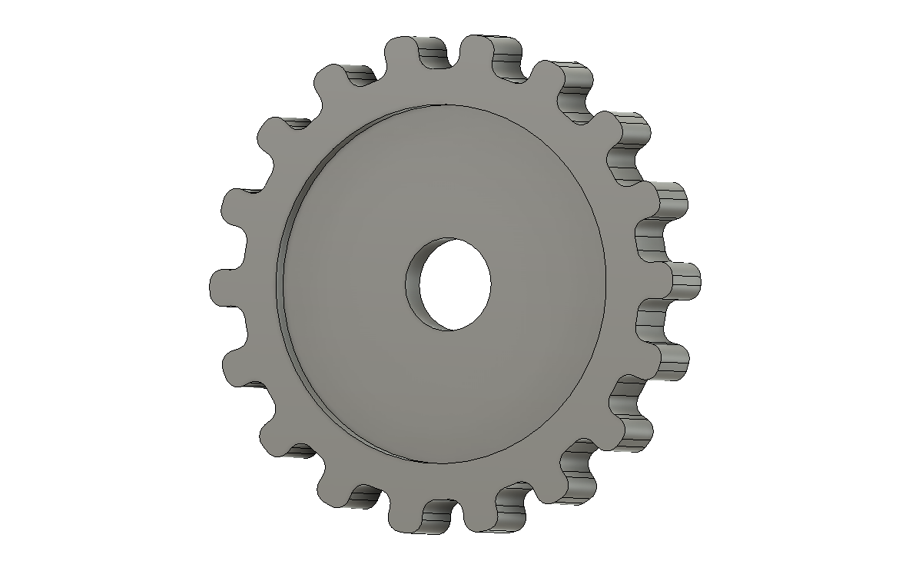
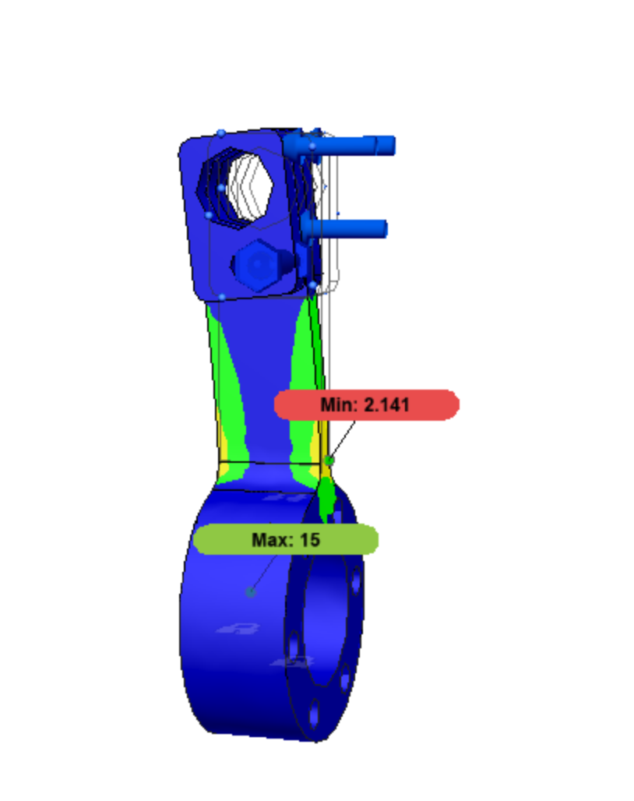
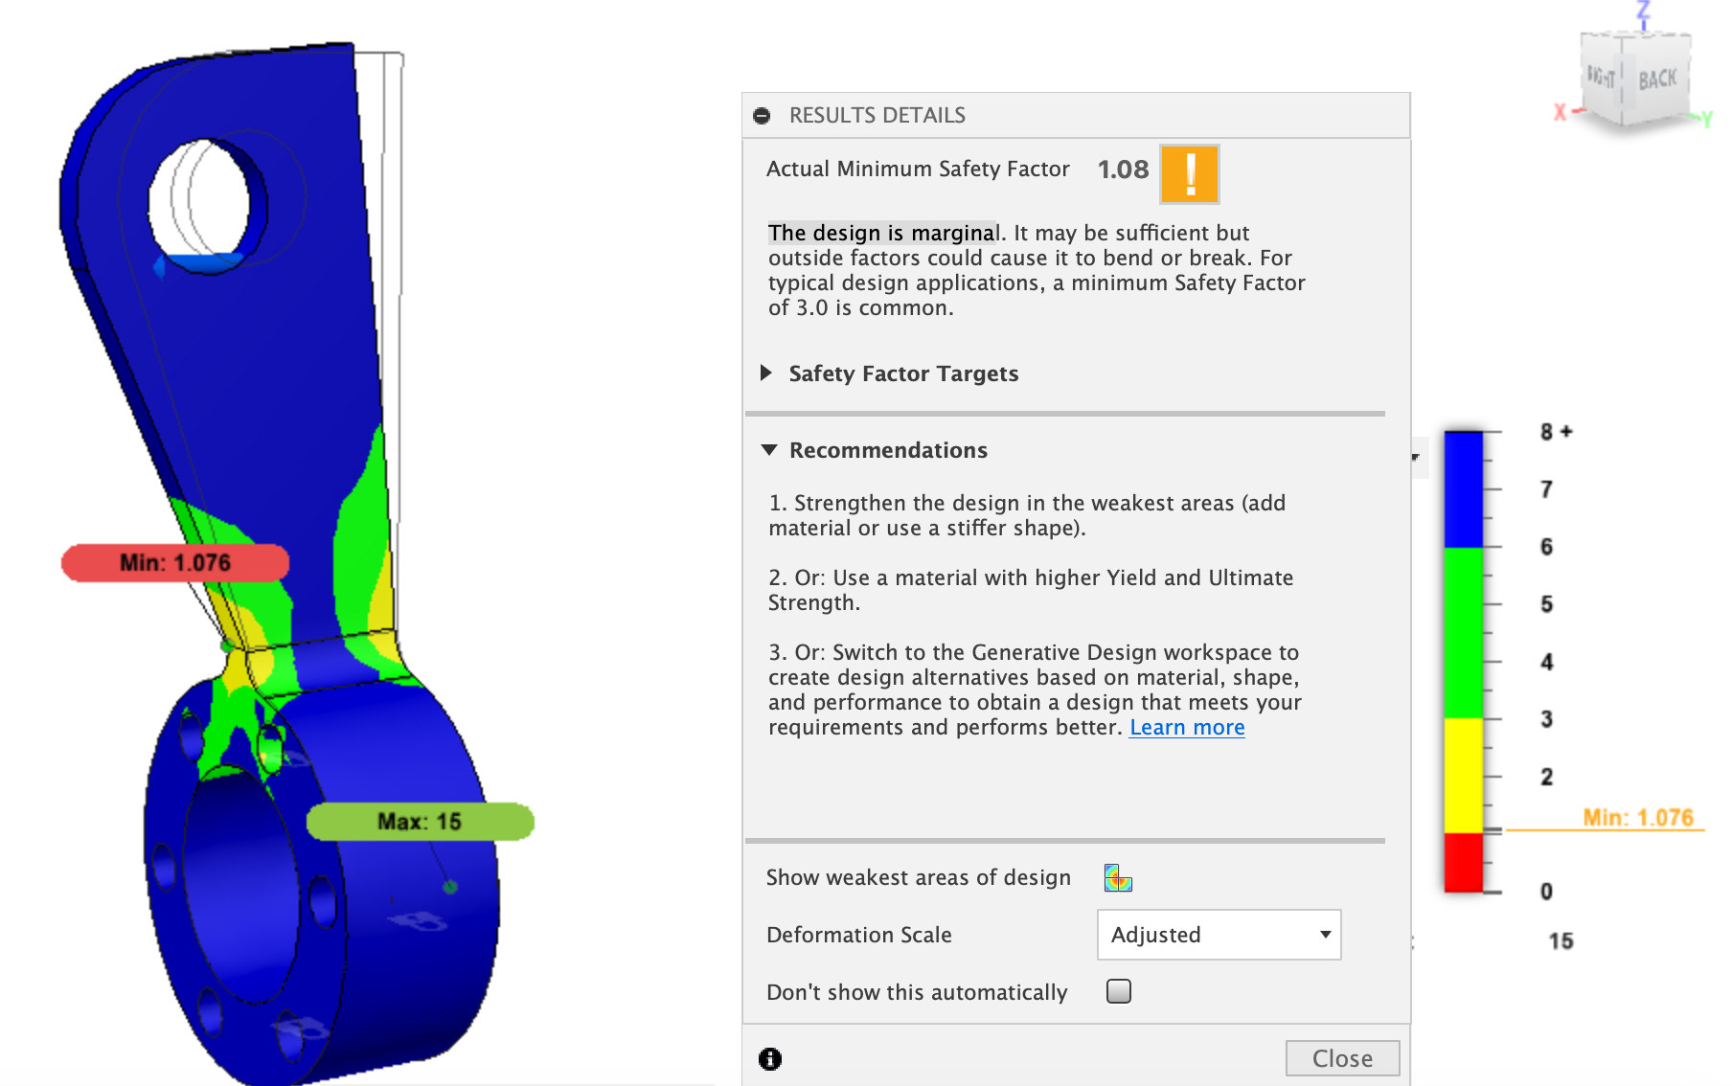
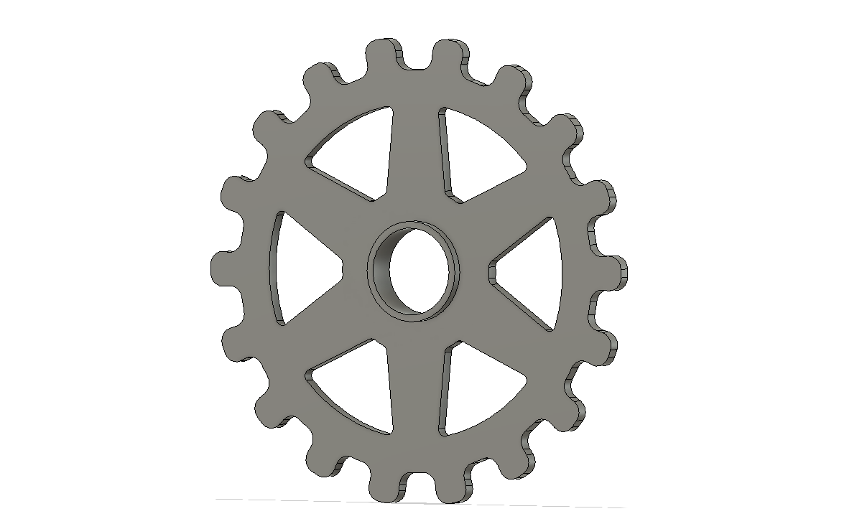
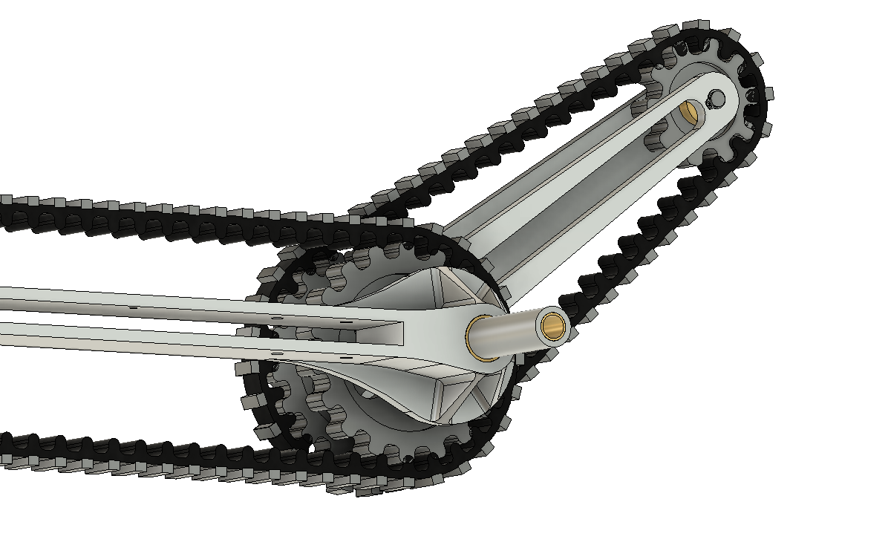
Refinements
Original
Improved
Original
Original
Improved
Improved
Tracks and Sprockets
FEA on force bearing components
Frame
Drive Mechanisms
Scissor Arm Functionality
Heat Protection
Notes:
Before we finalised our design we looked at each feature and used the SCAMPER method to see if we could improve upon them.
The final concept was based on splitting wheels but in order to improve reliability, simplicity and manoeuvrability this has been changed to tracks. With the use of tracks came other refinements. The sprockets were changed to have less material and lower inertia for better acceleration. The chassis is also designed with weight reduction in mind, reducing material whilst maintaining strength in the important areas.
The challenge of actuating the arm while minimising heat bridges was solved with a narrow slot in the layers of insulation, guarded by a rubber seal and uses the part detailed in the middle of the slide. From the original design, the use of FEA allowed us to improve the minimum safety factor by 2 and has allowed the design to be easily manufactured, assembled and allows the robot to be taken apart easier.

Slide 15
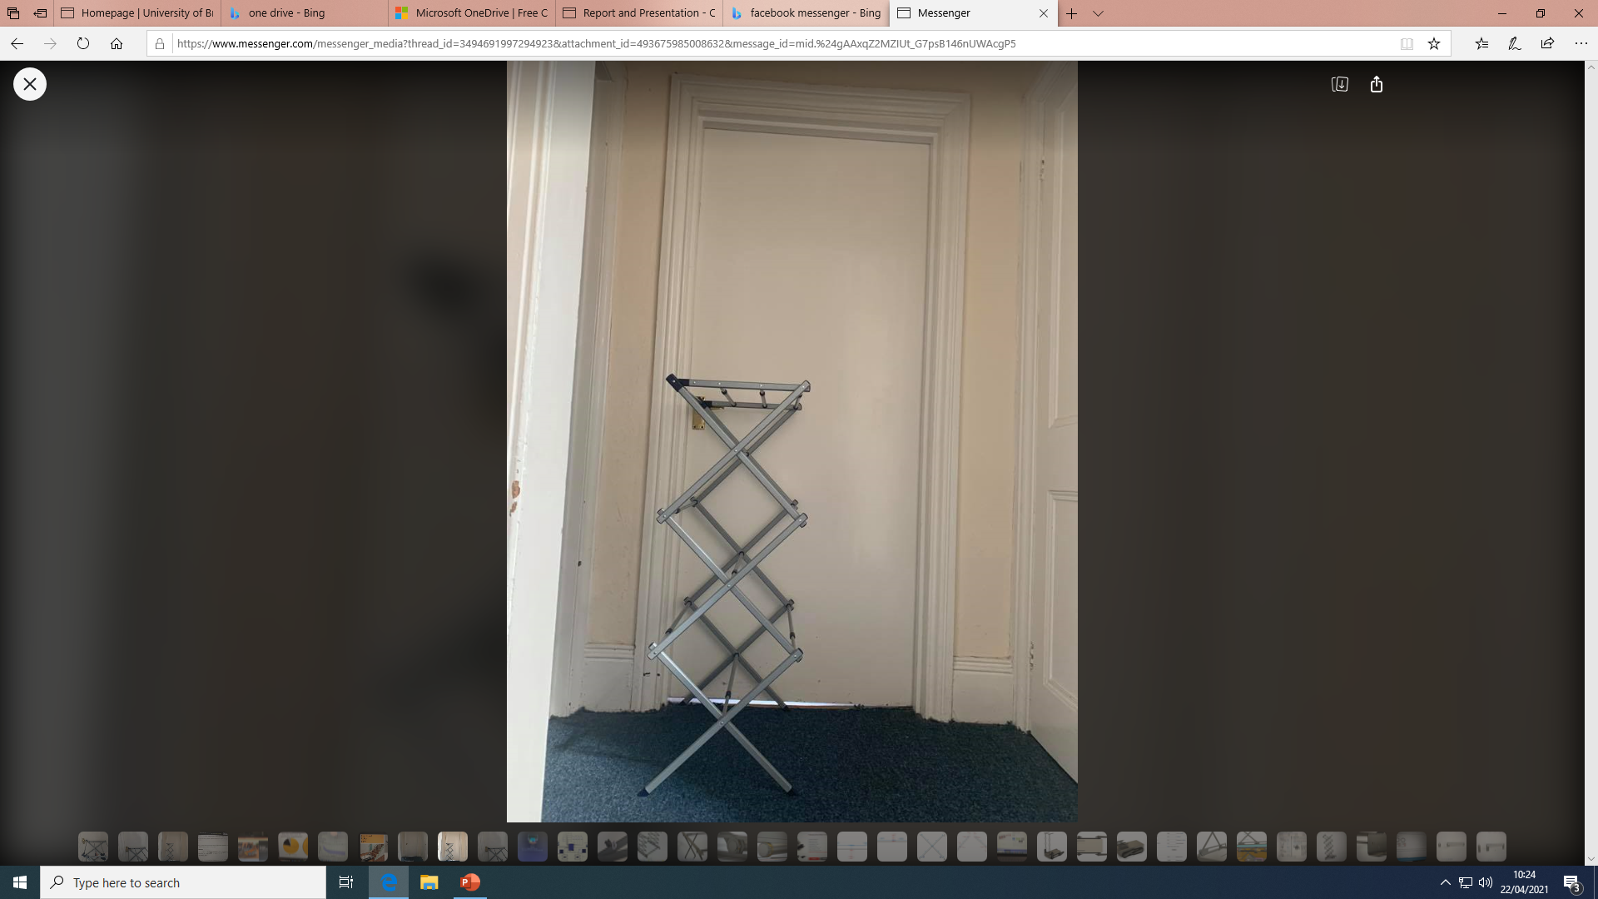
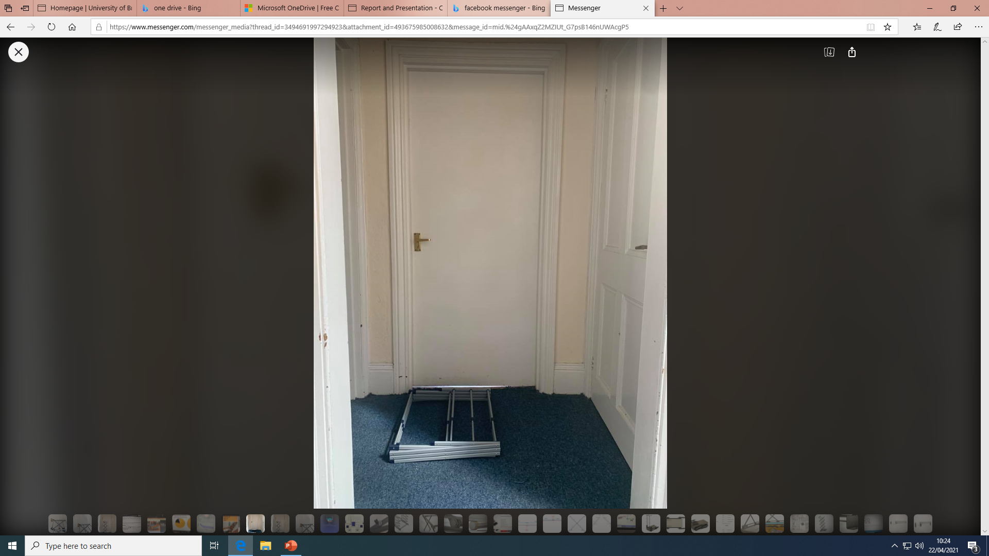
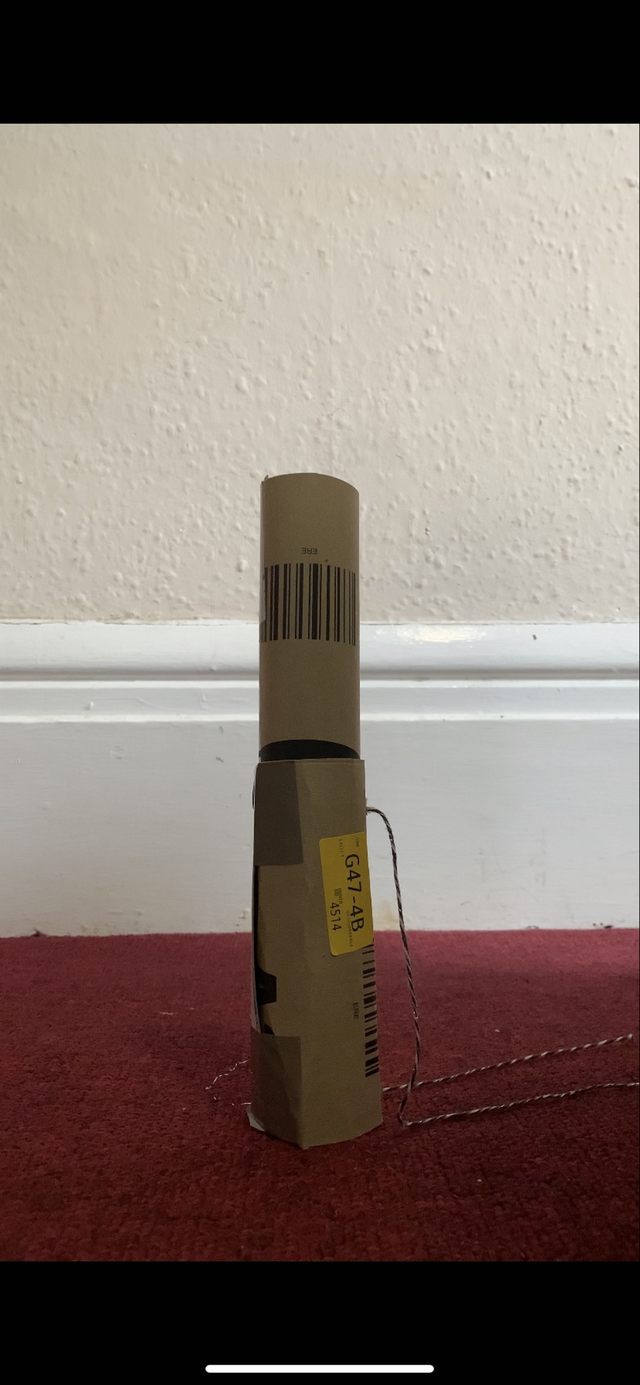
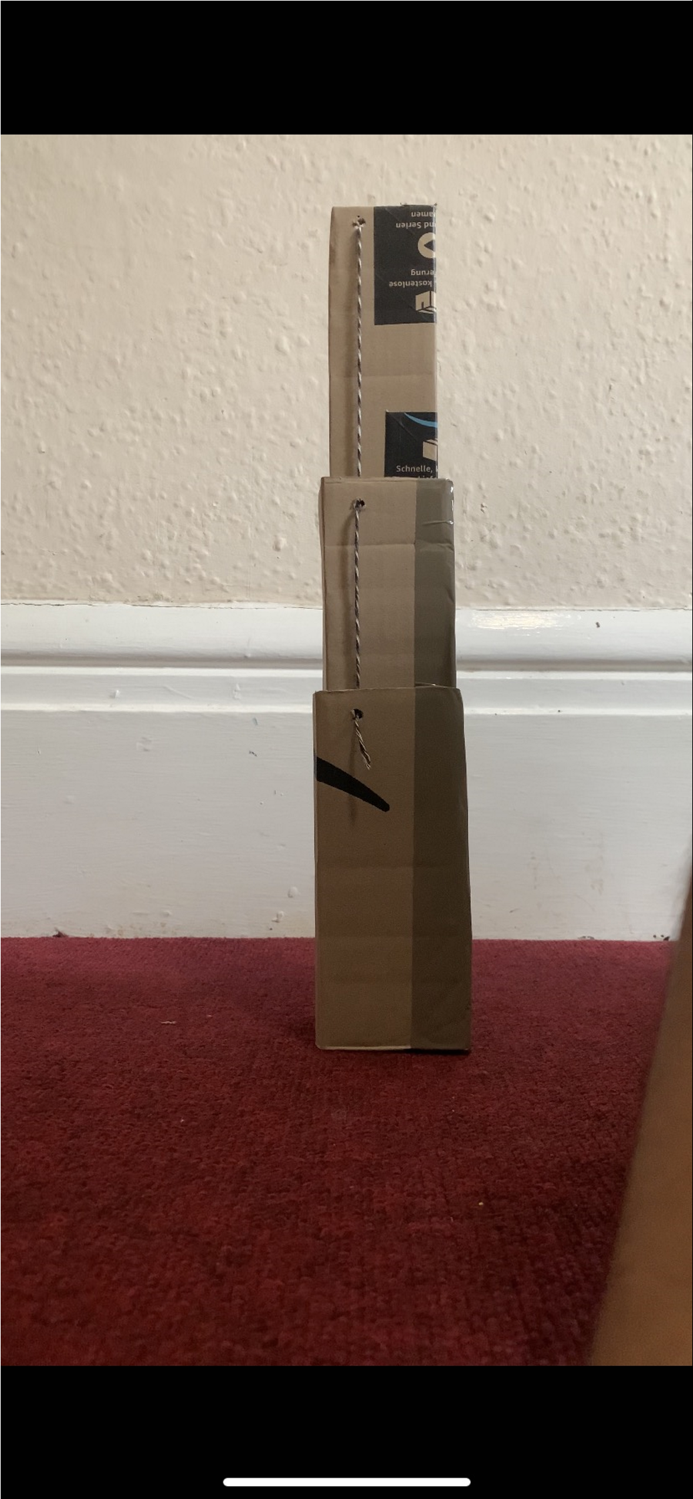
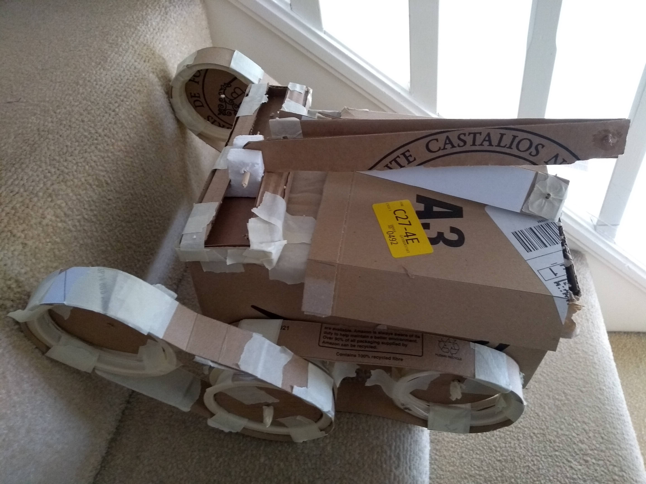
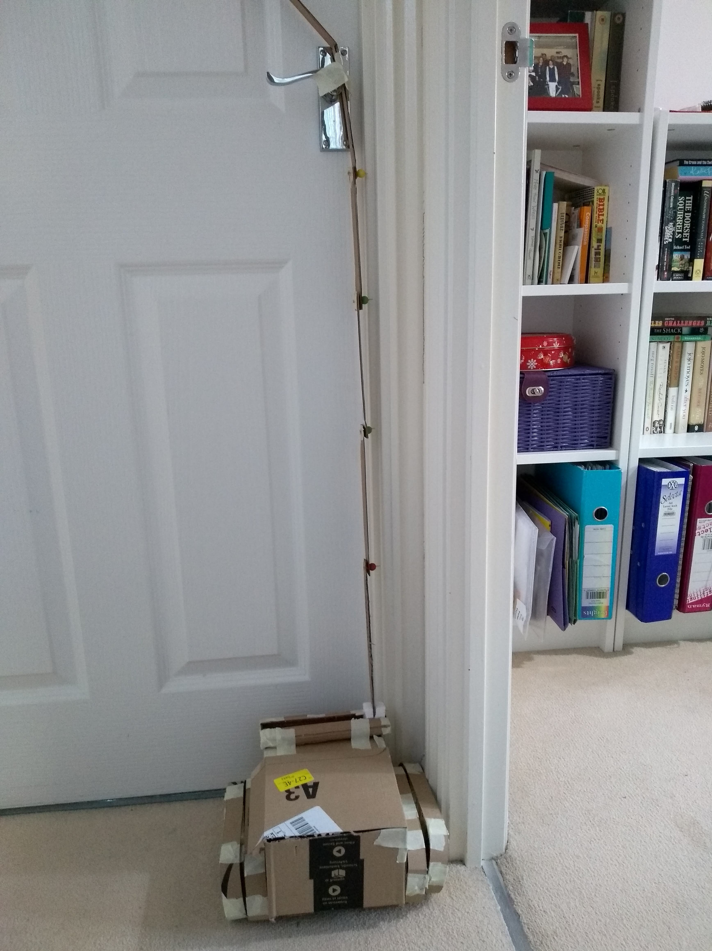
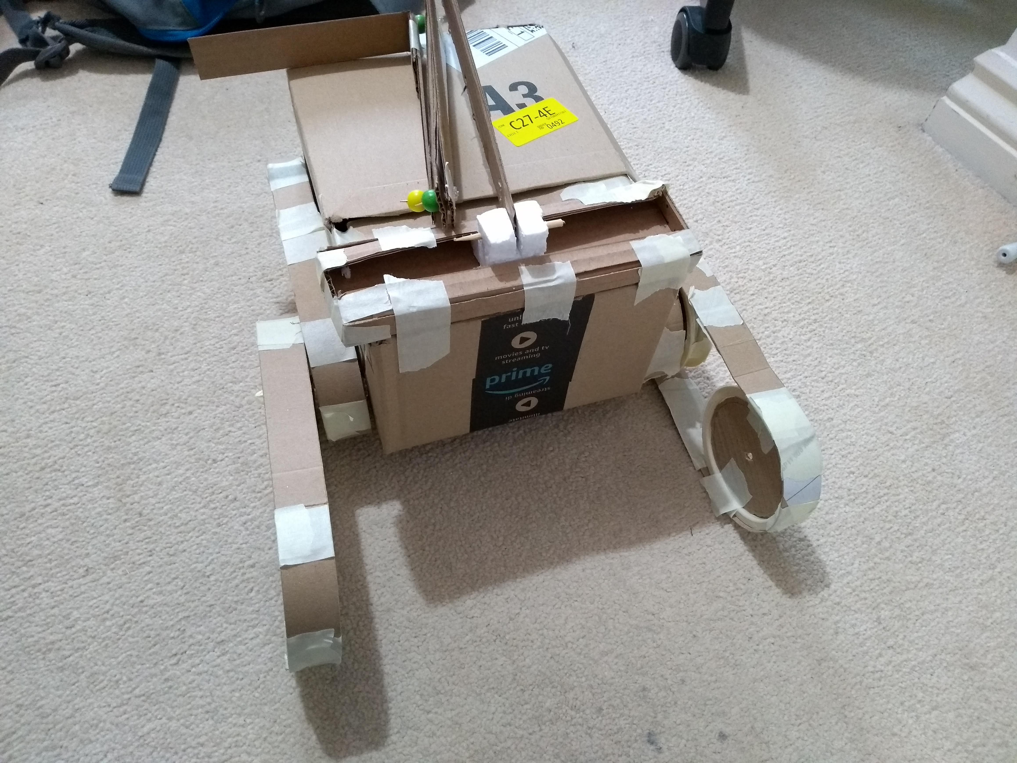
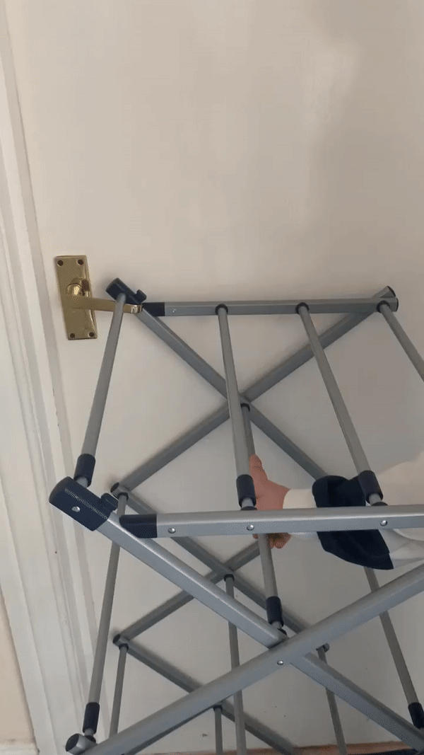
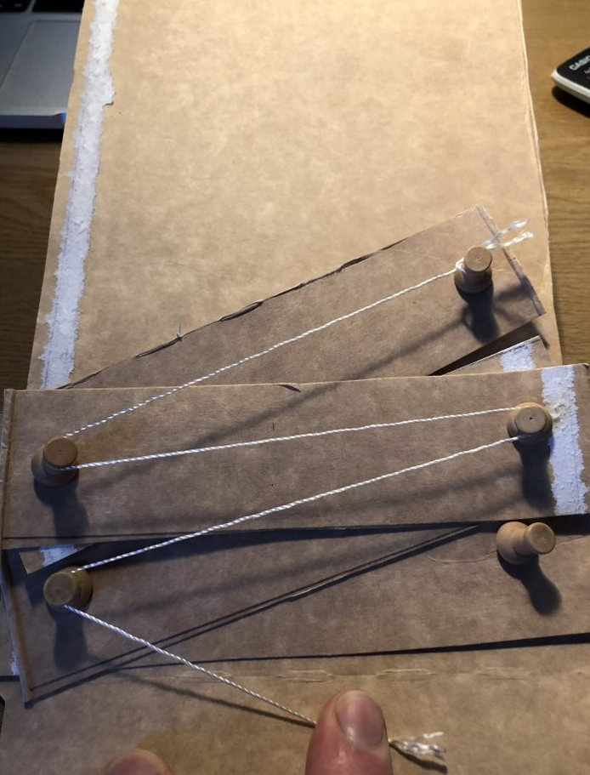

Prototyping

Slide 16

Chassis and Track Features
Machined Aluminium Frame Maximises Strength
Minimises Weight
Silicone Rubber Track with Steel Inserts
Extruded Aluminium Connections
Phosphor Bronze Bushings
Dual Shaft Drive
Cast Steel Sprockets
Notes:
After prototyping the final design was confirmed. The FireBee robot has a specifically designed dual shaft drive in order to power both the tracks and the flipper arms movement along the same axle. The inner shaft connects both flipper and will be driven by a stepper motor. The main drive is powered by two BLDC motors, one for each side allowing the tracks to be operated independently. Other features are detailed on this slide.

Slide 17


Scissor Lifting Arm
Lightweight & Strong
Lead Screw and Stepper Drive
Minimal Thermal Bridging
Notes:
The initial arm used in our concept was a folding arm controlled by pulleys and cables. We compared this to both the telescopic arm in concept 2 and the scissor lift used in concept 3 and decided to substitute it with the scissor lift, as this was simpler to manufacture, maintain and control. We used two scissor lifts to reduce the force acting on each and provide two connections to the handle across the top, reducing the moments acting on that, and preventing it from bending. The scissor lift is used to open lever door handles by raising above it, driving forward until the robot and handle hit the door, and then pulling down onto the handle to open it. The robot can then drive forward into the door to open it. We decided to use this method in our final design as it was the simplest to control and didn’t require the use of sensors, cameras or complex, multi-step control systems like some of our other ideas. The handle also extends both sides of the scissor lift to allow the robot to open doors with handles on both sides.

Slide 18

Key Material Choices
Fortron PPS
Paraffin Wax
Stainless Steel
Glass/Polyimide Honeycomb
Aluminium Shielding
Titanium Bolts
Phosphor Bronze Bushings
Machined Aluminium
Silicone Rubber with Steel Inserts
Notes:
When choosing the materials for the robot, we prioritised the properties that would enable it to fulfil its function when exposed to 200 degrees Celsius. The key material choices can be seen on this slide. When made with these materials, each part is able to withstand the forces acting on it whilst minimising the weight of the robot and thus increasing its efficiency and durability.

Slide 19


Functional Robust Lifesaving.
Notes:
The FireBee Robot final design is extremely robust and can carry out long duration tasks within a burning building without fail. It can climb stairs and open doors on command, fulfilling the functionality brief of the client. With the ability to attach payloads to the upper side and space for electronics inside, the FireBee can be very versatile and can be optimised to function autonomously.

Slide 20

Compact Size
65cm
35cm
89cm
Notes:
The Compact size of the robot allows it to be stored safely within a fire engine, transported in a bag by a single firefighter and deployed into a burning building with ease and even through small gaps. The robot weighs less than 45kg meaning that it can be carried by only one firefighter to the deployment zone.
To reduce size further, the scissor lift can be removed using basic tools reducing the packed size and allowing access to the batteries for charging.

Slide 21

Insulation Design
Notes:
This diagram displays the design of the insulation system for the robot. The body of the robot will be made of 2mm of Aluminium, followed by 20mm of glass/polymide honeycomb and will contain packages of parafin wax phase changing material labelled PCM on the slide. The PCM will be placed near the batteries and motors inside the robot body to maintain their working temperatures.

Slide 22



Insulation Analysis
Notes:
The insulation design was analysed using Simscape. The simscape model was build by combining thermal blocks to represent the rate of heat entering the body. The block on the side shows the model for the PCM. This allowed us to generate this graph which proved that the robot could spend up to 1.2 hours inside a house burning at 200 degrees before any of it's components start malfunctioning. This is a long time but a safety factor was included to account for more severe fires and the modelling assumptions that had to be made.

Slide 23

SimulIDE Circuit
^{User Input}
^{Control:}
^{Height of scissor lift}
^{Angle of flippers}
^{Speed of motor}
^{Direction of motor}
^{Rate of turns}
^{Stepper Motor}
Actuates the ascent and descent of the scissor lift to open doors
^{Stepper Motor}
^{DC Motors}
^{Powers the tracks of the robot}
Allows the robot to turn on the spot
^{Controls the flipper}
Notes:
Elian
48 minutes of runtime from the batteries

Slide 24

Remote Control
^{Arduino Pro Mini}
^{433MHz Antenna}
The brains of the remote control
Boosts the strength of the wireless signal
^{HC-12 Module}
^{2x Joysticks}
Allows for long range wireless communication between two Arduino boards with distances up to 1000m.
^{Controls the tracks of robot}
Left hand side for axial control
Right hand side for lateral control
^{Button}
1.20m
ACTIVATE SCISSOR LIFT
Initiates the door opening sequence
0°
180°
0°
180°
^{2x Potentiometers}
REAR
FRONT
0.8m
Dials to control the angle of the flippers
Tactile button built in to actuate flipper rotation
^{Slider}
Adjusts the height of the scissor lift
Notes:
This remote control allows the FireBee to be teleoperated from up to 1000m. Its design was inspired by RC controllers and gaming controllers currently available on the market. This means many users would already be familiar with the layout and therefore this intuitive design leads to an easy-to-use method of control requiring minimal training to operate the FireBee.

Slide 25

Power Supply System
Arm and Lift Battery Pack:
24V NiMH Rechargeable Battery Pack, 3.2Ah
Arm and Lift Motor:
Nema 23 Stepper motor (1.4 Nm)
Main Track Motor:
Nema 23 Brushless DC motor (0.3Nm)
Main Track Battery Pack:
36V NiMH Rechargeable Battery Pack, 4.2Ah
Planetary Gearbox (25.71:1)
Worm Gearbox (60:1)
Notes:
The power supply system consists of 5 motors and two batteries. Two of the motors are Nema 23 Brushless DC motor with a built in planetary gear box to move the main tracks of the robot and the other three are Nema 23 steppers powering the flippers and the scissor-lift with the help of a 60:1 worm gearbox. The two battery packs are both different voltage packs of Nichel Metal Hydride batteries. The size of the batteries ensure that the robot is able to drive non-stop for 48 minutes.

Slide 26

Manufacturing Solutions
Heavy Use of Standard Components
Cast Steel
CNC Machined Aluminium
Injection Moulded Fortron PPS
Aluminium and Steel Sheet
Notes:
The design has been created with ease of manufacturing in mind. There is heavy use of standard fittings, and mass manufacturing methods allowing large batches to be produced. The frame makes use of machined aluminium to reduce weight and allow maximum strength. The insulation frame will be manufactured from injection moulded Fortron, this high temperature polymer is light weight and allows production of large batches.
The majority of brackets and joining.components will be manufactured from steel and aluminium sheet also improving manufacturability

Slide 27





Calculations
Wheel Torque
Flipper Arm Torque
Scissor Lift Actuation
Scissor Lift Structure
Motor and Battery Requirements
Notes:
We conducted calculations for all the moving parts of our robot to ensure the motors supplied the required amount of force to drive the scissor lift and tracks. We also used calculations to ensure all the parts experiencing these forces were strong enough and stiff enough to withstand them.

Slide 28







Cost Analysis
£ 5050
£ 9560
£ 4070
1 FireBee
50 FireBees
500 FireBees
Notes:
A thorough material and manufacture cost research was conducted on all the parts of the robot to find the overall cost of the robot. It was found that there was a dramatic drop in final cost when the batch size reached 50, which we decided would be the most viable production size for this product. Although there was further reduction in cost when the batch size reached 500, this was less significant and unnecessary due to the nature of this product.

Slide 29

£5050¹ ^{A Low Cost For Saving A Life}
¹When manufactured in a small batch of 50
Notes:
In comparison to the existing fire robots that we found in our initial research, our robot offers a low cost for saving a life.

Slide 30

Achievements
100m in 100 seconds
Can open a closed door using a door handle
Can climb a straight flight of stairs in under 9 seconds
Can be carried and deployed by a single firefighter
Can withstand ground temperatures of a burning building for over one hour
Further Work
Pull doors open
Open a door-knob
Waterproofing housing
Size
Weight
Notes:
As you can see the FireBee is very successful in meeting the majority of client demands.
Although the robot can be carried by a single fire fighter it is still larger and heavier than the initial specification requirement. The actual values needed can be confirmed with the client and the design altered to suit these. Additionally, universal functionality with doors is something that can be explored further with the introduction of door knob opening mechanisms and modifications to allow the pulling of doors. The final point to look into is the housing of the robot, although largely sealed, the housing does have gaps to allow mechanism functionality. This works for heat protection however is something that should be tested to confirm whether waterproofing is possible allowing it to be operated while a fire is being put out.

